Slide 1
Planning for college 101

Slide 2
Discussion topics
Consider college characteristics
Academic preparation and standardized tests
Schedule a campus visit
Apply for admission
Finance your education

Slide 3
Options after high school Employed, Enrolled, Enlisted
Trade schools
Apprentice programs
Military
Todaysmilitary.com
ROTC
Community college
Public college or university
Private college or university

Slide 4
Choosing a Major:
What are you interested in? Do you want to work with people?
Undecided? Go to www.uakron.edu/career/students/

Slide 5
Consider college characteristics
Majors
Size
Admissions Policy
Campus Activities
Support Services
Location
Cost & Financial Assistance

Slide 6
Community college
Technical degrees
Transfer coursework
Partnership programs
Proximity to home
Affordable tuition
*Transfer scholarships are often lower than new freshman

Slide 7
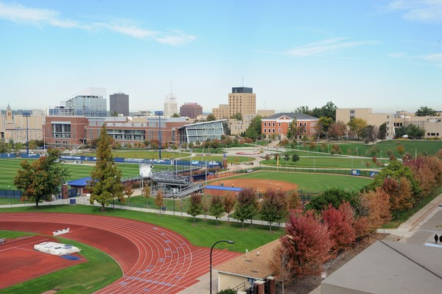
Public college or university
Affordable tuition
Wide range of academic programs
More student life opportunities
Large/diverse student population
Major sports programs

Slide 8
Private college or university
Low faculty/student ratio
Small class size
Personal attention
Strong financial aid and scholarship opportunities
May have a religious affiliation

Slide 9
Admissions policies- Is Getting into College Hard?
Open Admissions –
Almost all students are accepted
EX: Community College, ‘Branch Campus’- Wayne College
Selective Admissions –
Certain GPA and ACT/SAT scores required
EX: The University of Akron
Competitive Admissions –
High school course selection, GPA, and extracurricular involvement are highly evaluated
EX: Larger ‘Name Brand’ institutions
Competitive Majors and Pre-Admission–
Nursing, Social Work, Education

Slide 10
Ap vs. ccp
Advanced Placement (AP)
Credit earned by AP exam- not guaranteed
Curriculum structure is similar to other high school courses
College Credit Plus (CCP)
Ability to take courses not offered at HS
Credit earned by grade in each course
Curriculum is structured as a true college course
Save time & money

Slide 11
College admissions tests
SAT | VS | ACT
Reading: 1, 65-min section; Math: 1, 25-min section (no calculator) & 1, 55-min section (w/ calculator); Writing & Language: 1, 35-min section; Essay: 1, 50-min section (optional) | Test Format | English: 1, 45-min section; Math: 1, 60-min section; Reading: 1, 35-min section; Science: 1, 35-min section; Writing: 1, 40-min essay (optional)
Questions are evidence and context-based in an effort to focus on real-world situations and multi-step problem-solving | Test Style | Straightforward, questions may be long but are usually less difficult to decipher
Math and Evidence-Based Reading & Writing are each scored on a scale of 200-800. Composite SAT score is the sum of the two section scores and ranges from 400-1600 | Scoring | English, Math, Reading, and Science scores range from 1-36. Composite ACT score is the average of your scores on the four sections; ranges from 1-36
Seven times per year: March or April, May, June, August, October, November, December | Offered When? | Seven times per year: February, April, June, July, September, October, December
Typically about four weeks before the test date | Registration Deadline? | Typically about five to six weeks before the test date
 |  | ***NEW Individual Section Retake and Test Optional due to COVID-19
From StudyPoint.com

Slide 12
Schedule a campus visit
View Admissions webpage to schedule a visit
If possible, visit when school is in session (fall/spring)
There are many types of campus visit opportunities
www.uakron.edu/visit
In Person Information Session & Campus Tour (general information)
Virtual Sessions
Academic, Tour, Info Sessions
Virtual visits- Great first look, but still visit campus when allowed

Slide 13
Applying for Admission:
Narrow the choices:
Where did you feel was your best fit?
Review college admission test requirements
Know application fees and deadlines
Application for admission:
Most schools have an online application/common application
High school transcript
Test results (ACT or SAT)
Essays/Recommendations
Application Fee or Fee Waiver
Test Optional:
May not be requited to provide ACT/SAT
Are scores required for direct admission?
Placement tests

Slide 14
Finance your education
Sources of Financial Aid –
Federal and State Government
FAFSA (www.fafsa.gov)
Grants
Student Loans
Work-Study
College and University Scholarships
Need Based
Academic
Honors Program/College
Fine Arts
Marching Band
Transfer Scholarships

Slide 15
Additional scholarship sources
Colleges and Universities will only provide a certain amount
Employers or parents’ employers
Community/school/church
CollegeScholarships.org
FastWeb.com

Slide 16
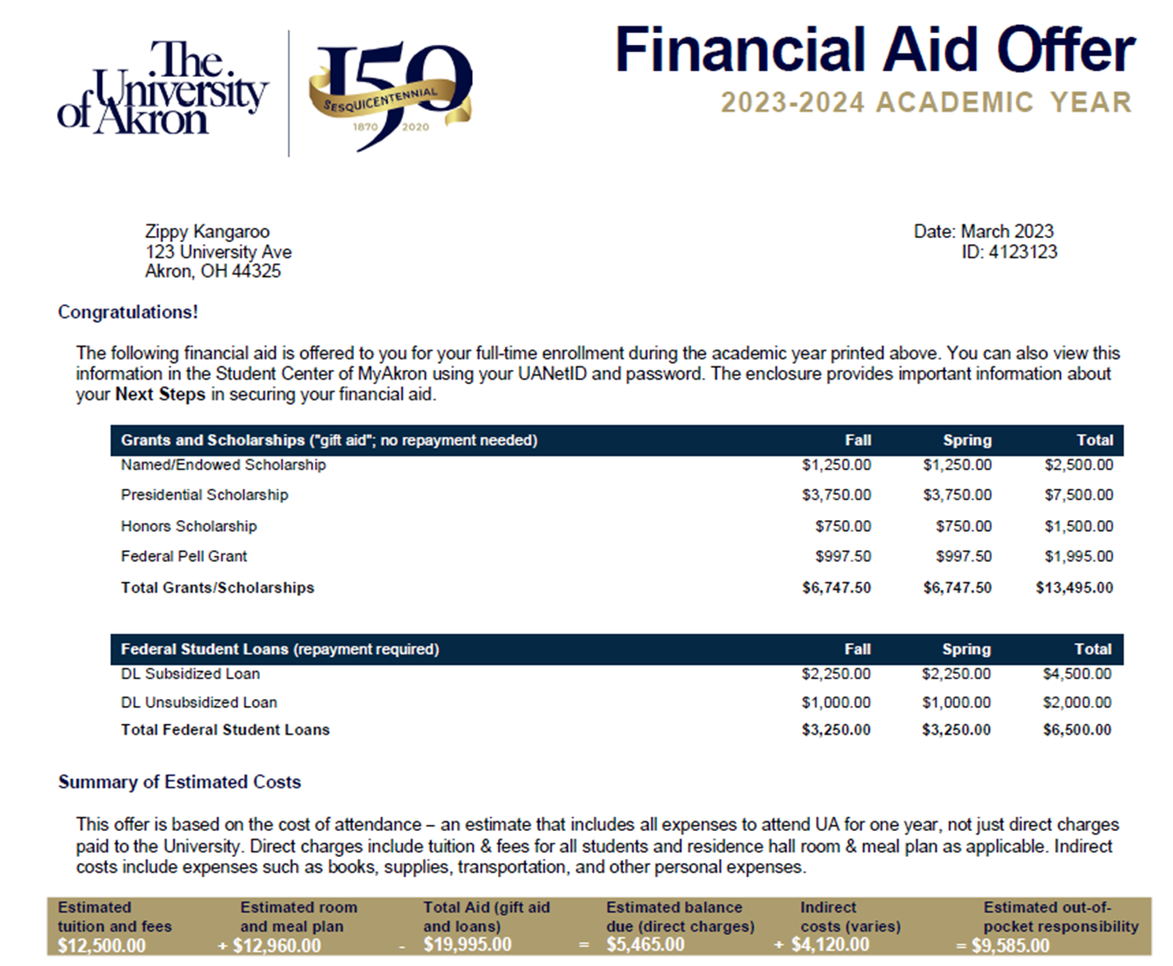

Slide 17
Aid Distribution
Academic Year $12,500 |  | Fall Semester $6,250 | Spring Semester $6,250
Merit Scholarship: $1,500 |  | $750 | $750
Pell Grant: $2,000 |  | $1,000 | $1,000
SEOG: $500 |  | $250 | $250
Sub Loan: $3,000 |  | $1,500 | $1,500
Unsub Loan: $2,000 |  | $1,000 | $1,000
Total Aid: $9,000 |  | $4,500 | $4,500
Out of Pocket Due: $3,500 |  | $1,750 | $1,750
Employers or parents’ employers
Community/school/church
CollegeScholarships.org
FastWeb.com

Slide 18
Cost of Tuition
Community College
Approx $6,000 per year
Public University (in-state)
Approx $12,500 per year
Private University
Approx $35,000 per year
Out of State Public
Approx $38,000
In State rate is $22,000 for the same school
Other Costs:
Housing
Meal Plan
Books
Supplies
Entertainment
Travel/Car

Slide 19
Chris Stimler
Associate Director of Admissions
The University of Akron
330.972.8433
cms107@uakron.edu

